Slide 1



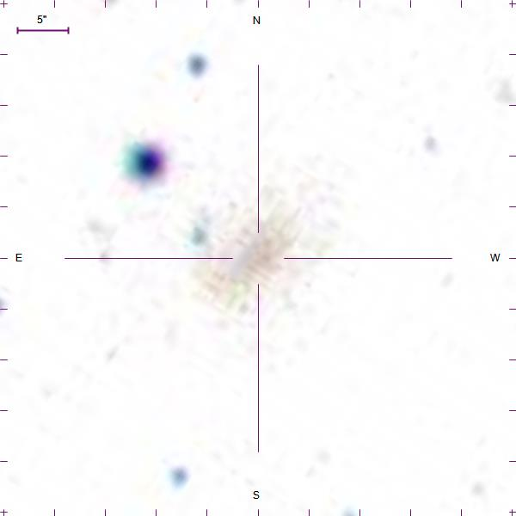
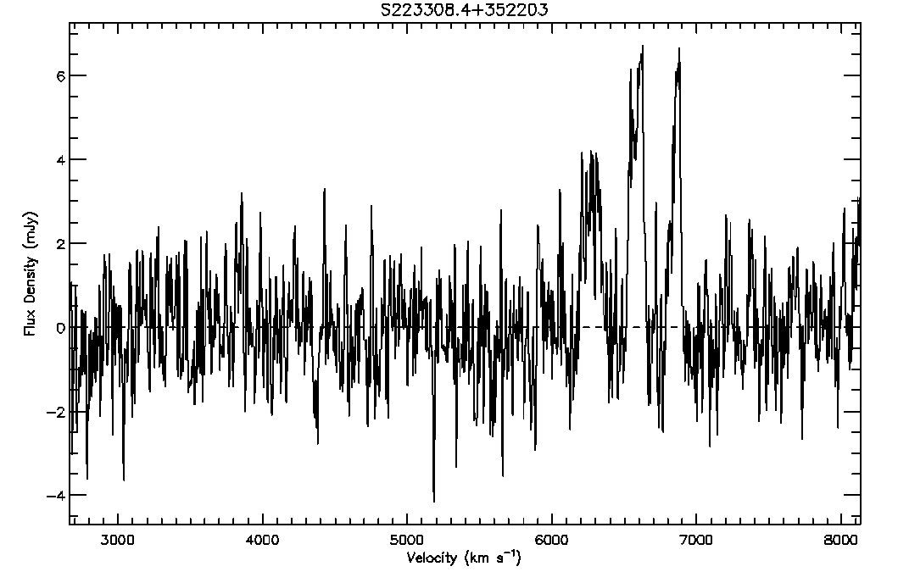
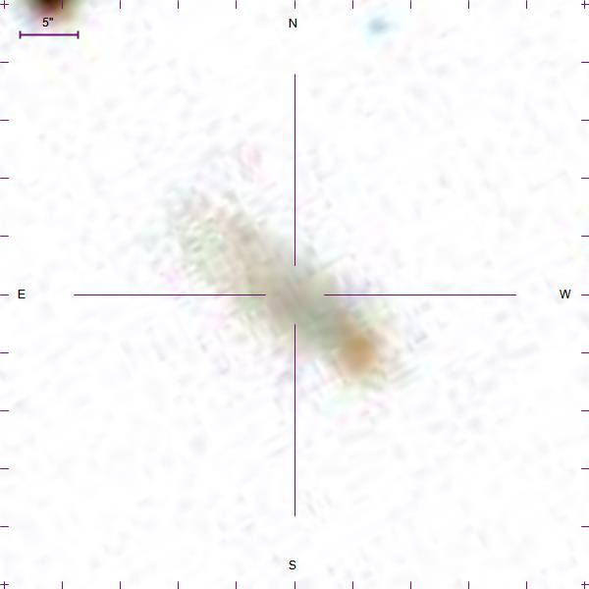
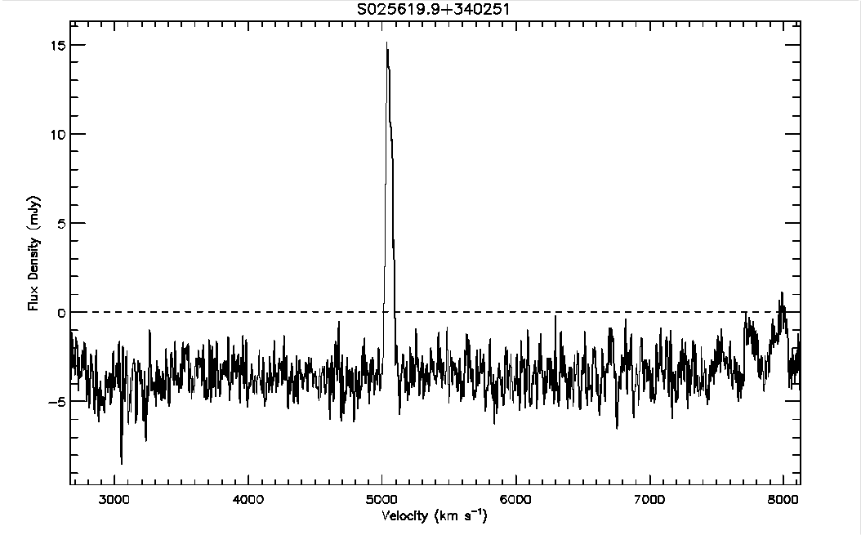
The Arecibo Pisces-Perseus Supercluster Survey: Declination Strip 35
Chelsey McMichael¹, J. Ribaudo¹, R. Koopmann², M. Haynes³, APPSS Team, Undergraduate ALFALFA Team, ALFALFA Team, ¹Utica College, ²Union College, ³Cornell University
The Arecibo Pisces-Perseus Supercluster Survey (APPSS) will provide strong observational constraints on the mass-infall rate onto the main filament of the Pisces-Perseus Supercluster. The survey data consist of HI emission-line spectra of cluster galaxy candidates, obtained primarily at the Arecibo Observatory (with ALFA as part of the ALFALFA Survey and with the L-Band Wide receiver as part of APPSS observations). Here we present the details of the data reduction process and spectral-analysis techniques used to determine if a galaxy candidate is at a velocity consistent with the Supercluster, as well as the detected HI-flux and rotational velocity of the galaxy, which will be used to estimate the corresponding HI-mass. We discuss the results of a preliminary analysis on a subset of the APPSS sample, corresponding to 98 galaxies located within ~1.5° of DEC = +35.0°, with 65 possible detections. We also highlight several interesting emission-line features and galaxies discovered during the reduction and analysis process and layout the future of the APPSS project.
This work has been supported by NSF grants AST-1211005 and AST-1637339.
ABSTRACT
Figure 6 (Above): The distribution of sources on the sky in the region of the PPS. In green are the AGC and ALFALFA sources, while the APPSS Declination Strip 35 targets are shown in red and blue. Red denotes a tentative HI-source detection and blue denotes a non-detection. Figure 7 (Below): The systemic velocity of HI-sources plotted as a function of RA. APPSS Declination Strip 35 sources are shown in red, while ALFALFA sources are shown in grey. The main filament of the PPS can be seen around +5,000 km/s.
The goal of the Arecibo Pisces-Perseus Supercluster Survey (APPSS) is to determine the mass-infall rate onto the main filament of the Pisces-Perseus Supercluster (PPS)
PPS galaxy candidates were observed at Arecibo Observatory, L-Band Wide (1.15-1.73 GHz)
Rather than detecting light of stars within a galaxy, the APPSS Survey identifies light emitted by hydrogen atoms within a galaxy candidate
APPSS
Shown above is a visual representation of the reduction/analysis process of a galaxy spectrum, where in each panel the flux density is plotted as a function of velocity (a velocity of 0 km/s corresponds to a wavelength of 21-cm). Figure 1 (left) shows the process of normalizing the spectrum by setting the baseline. In this case, the yellow regions are used to produce a polynomial fit that sets the baseline. Note we avoid the region near +4,000 km/s which corresponds to RFI during the observation. With a normalized spectrum, Figure 2 (center) shows the selection window in red of the HI-signal to be analyzed. There are two fit options to measure the emission-line properties: gaussian or 2-horned profile. Figure 3 (right) shows a 2-horned profile fit, where we have manually set the left and right sides of a trapezoid (red solid lines). From this fit we estimate various properties of the emission, including the velocity centroid, the width of the line, and the integrated flux density, which are used to estimate the distance to, and HI-mass of, the source.
Interesting Sources
There seems to be multiple detections in the sample. The peak nearest 7000 km/s could be harmonic beeper interference
The SDSS catalog shows a faint galaxy
Figure 4 (Left) shows the log of the HI mass versus the distance to the sources from ALFALFA (grey) and APPSS Declination Strip 35 (red). The galaxy distances are determined from Hubble’s Law (using H₀=70 km/s/Mpc) and the HI-mass from the relationship shown below. As expected, the longer exposures in APPSS allows for greater sensitivity to low HI-mass sources, compared to ALFALFA.
This peculiar galaxy has a prominent signal peaking around 5000 km/s, it was difficult to determine whether the RFI required a gaussian or two-peaked fit
The SDSS catalog reveals it is not an elliptical galaxy, thus it is more likely to be a two-peaked fit
Note the gap in the ALFALFA data (left), which is caused by RFI from the nearby airport. Figure 5 (Right) shows the integrated flux of the emission-line source as a function of line-width. Note the superior sensitivity of the Declination Strip 35 detections compared to the ALFALFA sources (the result of increased exposure time for APPSS targets). consists of detections with much lower values for velocity and flux than the data of the ALFALFA catalog.
Equation Here

